Slide 1
Problem Statement & Approach Presentation

Slide 2
Problem Statement
Study area: change detection in earth observation data is the task of recognizing changes on Earth by comparing two or more satellite or aerial images covering the same area at different times.
Focus on bi-temporal change detection where changes are detected between two images
Main goal is detection of extreme changes such as natural disasters
Objective: design a deep learning based solution for solving the bi-temporal change detection problem in heterogenous source images
The used satellite images’ spatial resolution allow for change detection in ground coverage
Not suitable for dealing small objective trees, cars and such
Data: the differences between the two images are the following
Domain shift between the two imaging modalities
Simple transformation
Temporal difference
Each pixel maps to a corresponding on the other modality

Slide 3
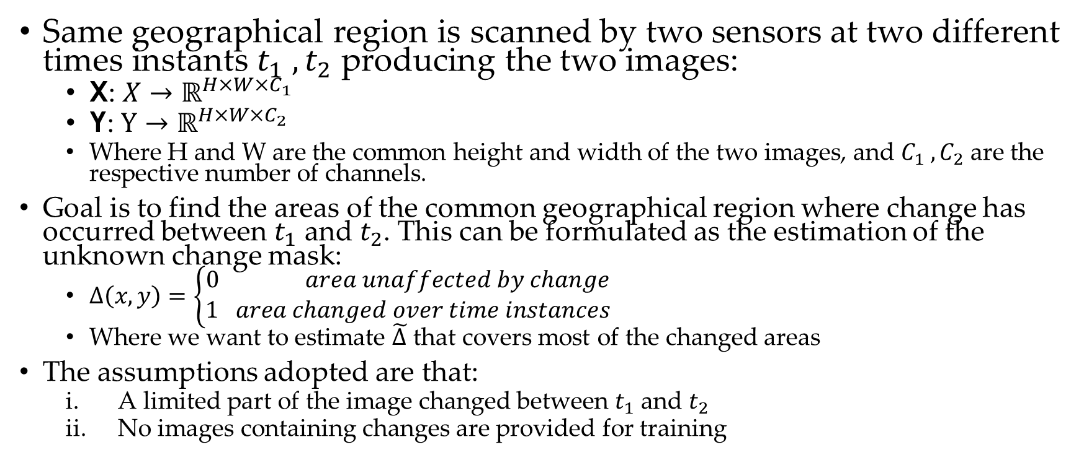
Problem Formulation
Same geographical region is scanned by two sensors at two different times instants $t_{1} , t_{2}$ producing the two images:
X: $X→ℝ^{H×W×C_{1}}$
Y: $Y→ℝ^{H×W×C_{2}}$
Where H and W are the common height and width of the two images, and $C_{1} , C_{2}$ are the respective number of channels.
Goal is to find the areas of the common geographical region where change has occurred between $t_{1}$ and $t_{2}$. This can be formulated as the estimation of the unknown change mask:
$∆\left(x,y\right)=\left\{\begin{aligned}0 area unaffected by change \\ 1 area changed over time instances\end{aligned}\right.$
Where we want to estimate $\tilde{∆}$ that covers most of the changed areas
The assumptions adopted are that:
A limited part of the image changed between $t_{1}$ and $t_{2}$
No images containing changes are provided for training

Slide 4
Review of the paper: Deep Image Translation with an Affinity-Based Change Prior for Unsupervised Multimodal Change Detection
Approach is divided in two phases
Prior computation
Deep learning model for final change detection trained on patches with low likelihood of change
Apply trained model to all patches and compare with original patches across both modalities and use reconstruction to find change maps
Proposed deep learning models
X-Net
ACE-Net
Luppino, Luigi Tommaso & Kampffmeyer, Michael & Bianchi, Filippo Maria & Moser, Gabriele & Serpico, Sebastiano & Jenssen,
Robert & Anfinsen, Stian. (2020). Deep Image Translation with an Affinity-Based Change Prior for Unsupervised Multimodal Change Detection.

Slide 5
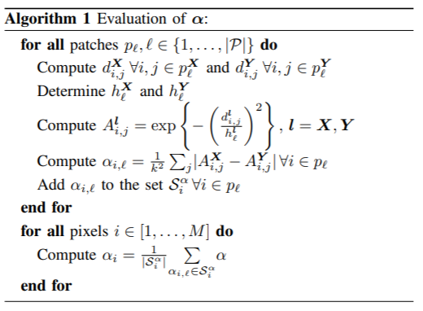
Prior computation
Find a coarse detection map
For each pair of corresponding patches compute the pairwise pixel distances and apply a gaussian kernel
Create affinity matrices from differences in each modality
Compute difference between the affinity matrices and threshold
Luppino, Luigi Tommaso & Kampffmeyer, Michael & Bianchi, Filippo Maria & Moser, Gabriele & Serpico, Sebastiano & Jenssen,
Robert & Anfinsen, Stian. (2020). Deep Image Translation with an Affinity-Based Change Prior for Unsupervised Multimodal Change Detection.

Slide 6
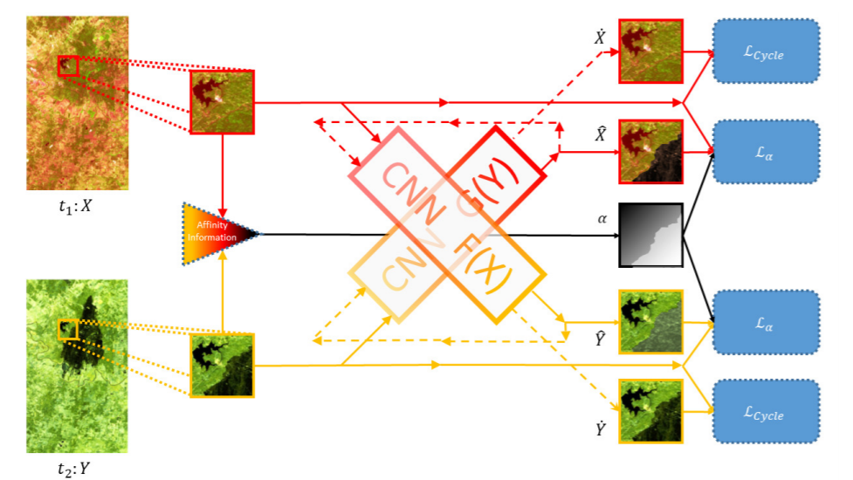
X-Net
Luppino, Luigi Tommaso & Kampffmeyer, Michael & Bianchi, Filippo Maria & Moser, Gabriele & Serpico, Sebastiano & Jenssen,
Robert & Anfinsen, Stian. (2020). Deep Image Translation with an Affinity-Based Change Prior for Unsupervised Multimodal Change Detection.

Slide 7
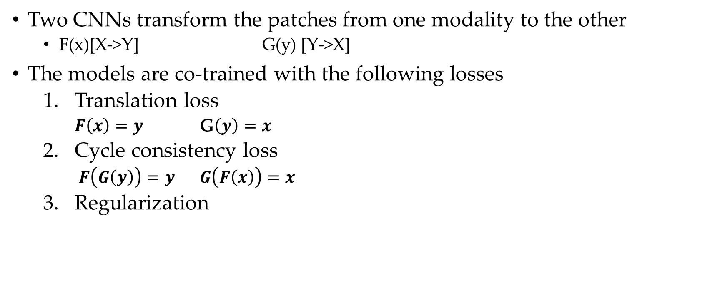
X-Net
Two CNNs transform the patches from one modality to the other
F(x)[X->Y] G(y) [Y->X]
The models are co-trained with the following losses
Translation loss
$F\left(x\right)=y$ G$\left(y\right)=x$
Cycle consistency loss
$F\left(G\left(y\right)\right)=y$ $G\left(F\left(x\right)\right)=x$
Regularization
Luppino, Luigi Tommaso & Kampffmeyer, Michael & Bianchi, Filippo Maria & Moser, Gabriele & Serpico, Sebastiano & Jenssen,
Robert & Anfinsen, Stian. (2020). Deep Image Translation with an Affinity-Based Change Prior for Unsupervised Multimodal Change Detection.

Slide 8
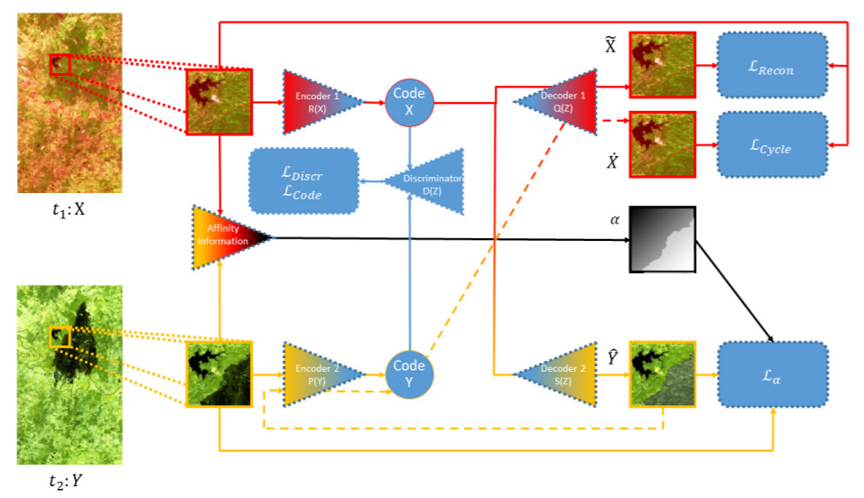
ACE-Net
Luppino, Luigi Tommaso & Kampffmeyer, Michael & Bianchi, Filippo Maria & Moser, Gabriele & Serpico, Sebastiano & Jenssen,
Robert & Anfinsen, Stian. (2020). Deep Image Translation with an Affinity-Based Change Prior for Unsupervised Multimodal Change Detection.

Slide 9
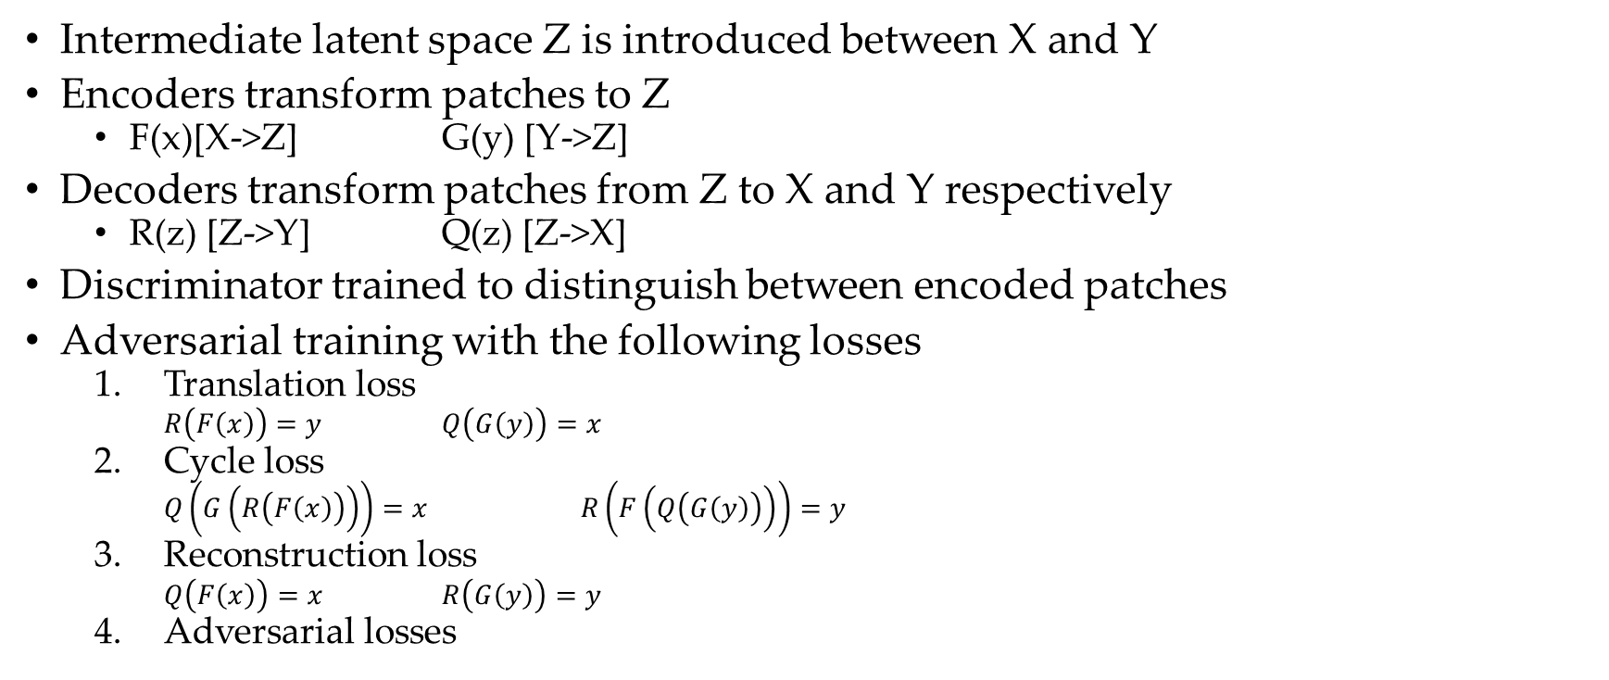
ACE-Net
Intermediate latent space Z is introduced between X and Y
Encoders transform patches to Z
F(x)[X->Z] G(y) [Y->Z]
Decoders transform patches from Z to X and Y respectively
R(z) [Z->Y] Q(z) [Z->X]
Discriminator trained to distinguish between encoded patches
Adversarial training with the following losses
Translation loss
$R\left(F\left(x\right)\right)=y$ $Q\left(G\left(y\right)\right)=x$
Cycle loss
$Q\left(G\left(R\left(F\left(x\right)\right)\right)\right)=x$ $R\left(F\left(Q\left(G\left(y\right)\right)\right)\right)=y$
Reconstruction loss
$Q\left(F\left(x\right)\right)=x$ $R\left(G\left(y\right)\right)=y$
Adversarial losses
Luppino, Luigi Tommaso & Kampffmeyer, Michael & Bianchi, Filippo Maria & Moser, Gabriele & Serpico, Sebastiano & Jenssen,
Robert & Anfinsen, Stian. (2020). Deep Image Translation with an Affinity-Based Change Prior for Unsupervised Multimodal Change Detection.

Slide 10
Proposed solution
A pure deep learning model
Implementing a similar framework to the reviewed paper
Semi-supervised approach
Datasets
Sarptical: 10,000+ pairs of no change corresponding pairs of SAR and optical images
Changed image pairs for testing with ground truth
Gloucester flooding event
California flooding event
Texas forest fire

Slide 11
Architecture
X-net/ACE-net trained on Sarptical dataset for coarse map creation
Train fine change detection using low likelihood of change patches
Fine tune the X-net
Train a deep regression model from scratch
Use a traditional machine learning regressor
Compute translation error for each patch and threshold to find change map

